Slide 1
Anaplan
Go-to-market Planning Applications
Segmentation & Scoring
Technical Overview
Application Version 1.1.0
Last updated July 2, 2025

Slide 2
Confidentiality notice
This documentation and any related materials are provided solely for the use of authorized Anaplan customers who have purchased the Segmentation and Scoring Application and are considered Anaplan proprietary information. The information contained herein is intended exclusively for the purpose of implementing the application by authorized customers. Any use outside of this intended purpose is strictly prohibited, including but not limited to:
  Sharing, distributing, or disclosing this content with or to individuals or entities not directly involved in the customer’s authorized implementation.
  Using the documentation, in whole or in part, to replicate, retrofit, or reverse-engineer the functionality in other models, environments, or platforms.
This documentation contains proprietary information of Anaplan and is protected by applicable intellectual property laws.
Any unauthorized use, reproduction, or dissemination is a violation of these terms and may result in legal action.

Slide 3

Table of Contents
1
Overview
2
Process and configurable elements
3
Prework and assumptions
4
Model design

Slide 4
Overview
Section 1

Slide 5
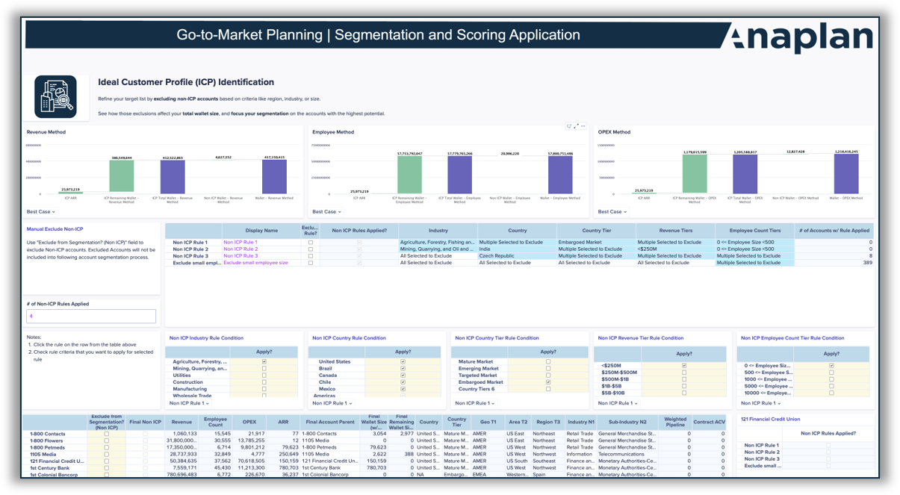
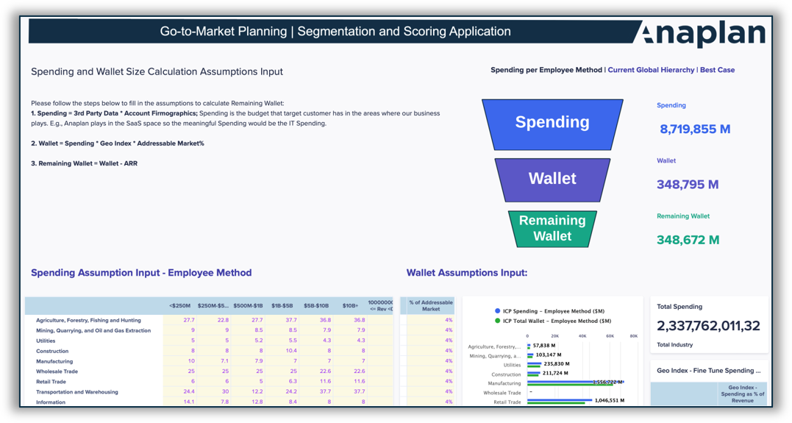
Segmentation and scoring
Out-of-the-Box functionalities to define ICP, quantify wallet size, score accounts, and segment markets
Market maturity analysis
  Define country tiering based on market maturity and growth potential.
  Classify markets by expansion potential and buying behavior to guide GTM strategy.
  Flag restricted or embargoed markets and assess business impact.
GTM performance review
  Analyze sales, CS, and marketing performance across customizable dimensions.
  Uncover upsell and cross-sell opportunities to grow accounts.
  Support CRO-level insights with prebuilt trend and resource analyses and optimization.
Ideal Customer Profile (ICP) and wallet sizing
  Filter out unwanted accounts using predefined ICP criteria (for example, size, region, industry).
  Quantify the wallet size impact of excluded accounts.
  Choose from multiple wallet size calculation methods.
  Compare methodologies to identify the best fit by industry or other dimensions.
  Simulate wallet size scenarios and flag outliers.
  Empower targeting and account prioritization with real-time ICP insights.
Account segmentation
  Score and segment accounts based on firmographics and key attributes.
  Apply rule-based or score-based segmentation with configurable metrics.
  Track segmentation changes year-over-year.
  Identify capacity gaps in real time as segments shift.
  Capture field input with built-in feedback workflows.
Hierarchy refinement
  Visualize and adjust account hierarchies for greater accuracy.
  Aggregate firmographics to improve scoring consistency.
  Group child accounts under parent organizations for clearer GTM execution.
  Align hierarchy structures with GTM strategies to avoid planning missteps.

Slide 6
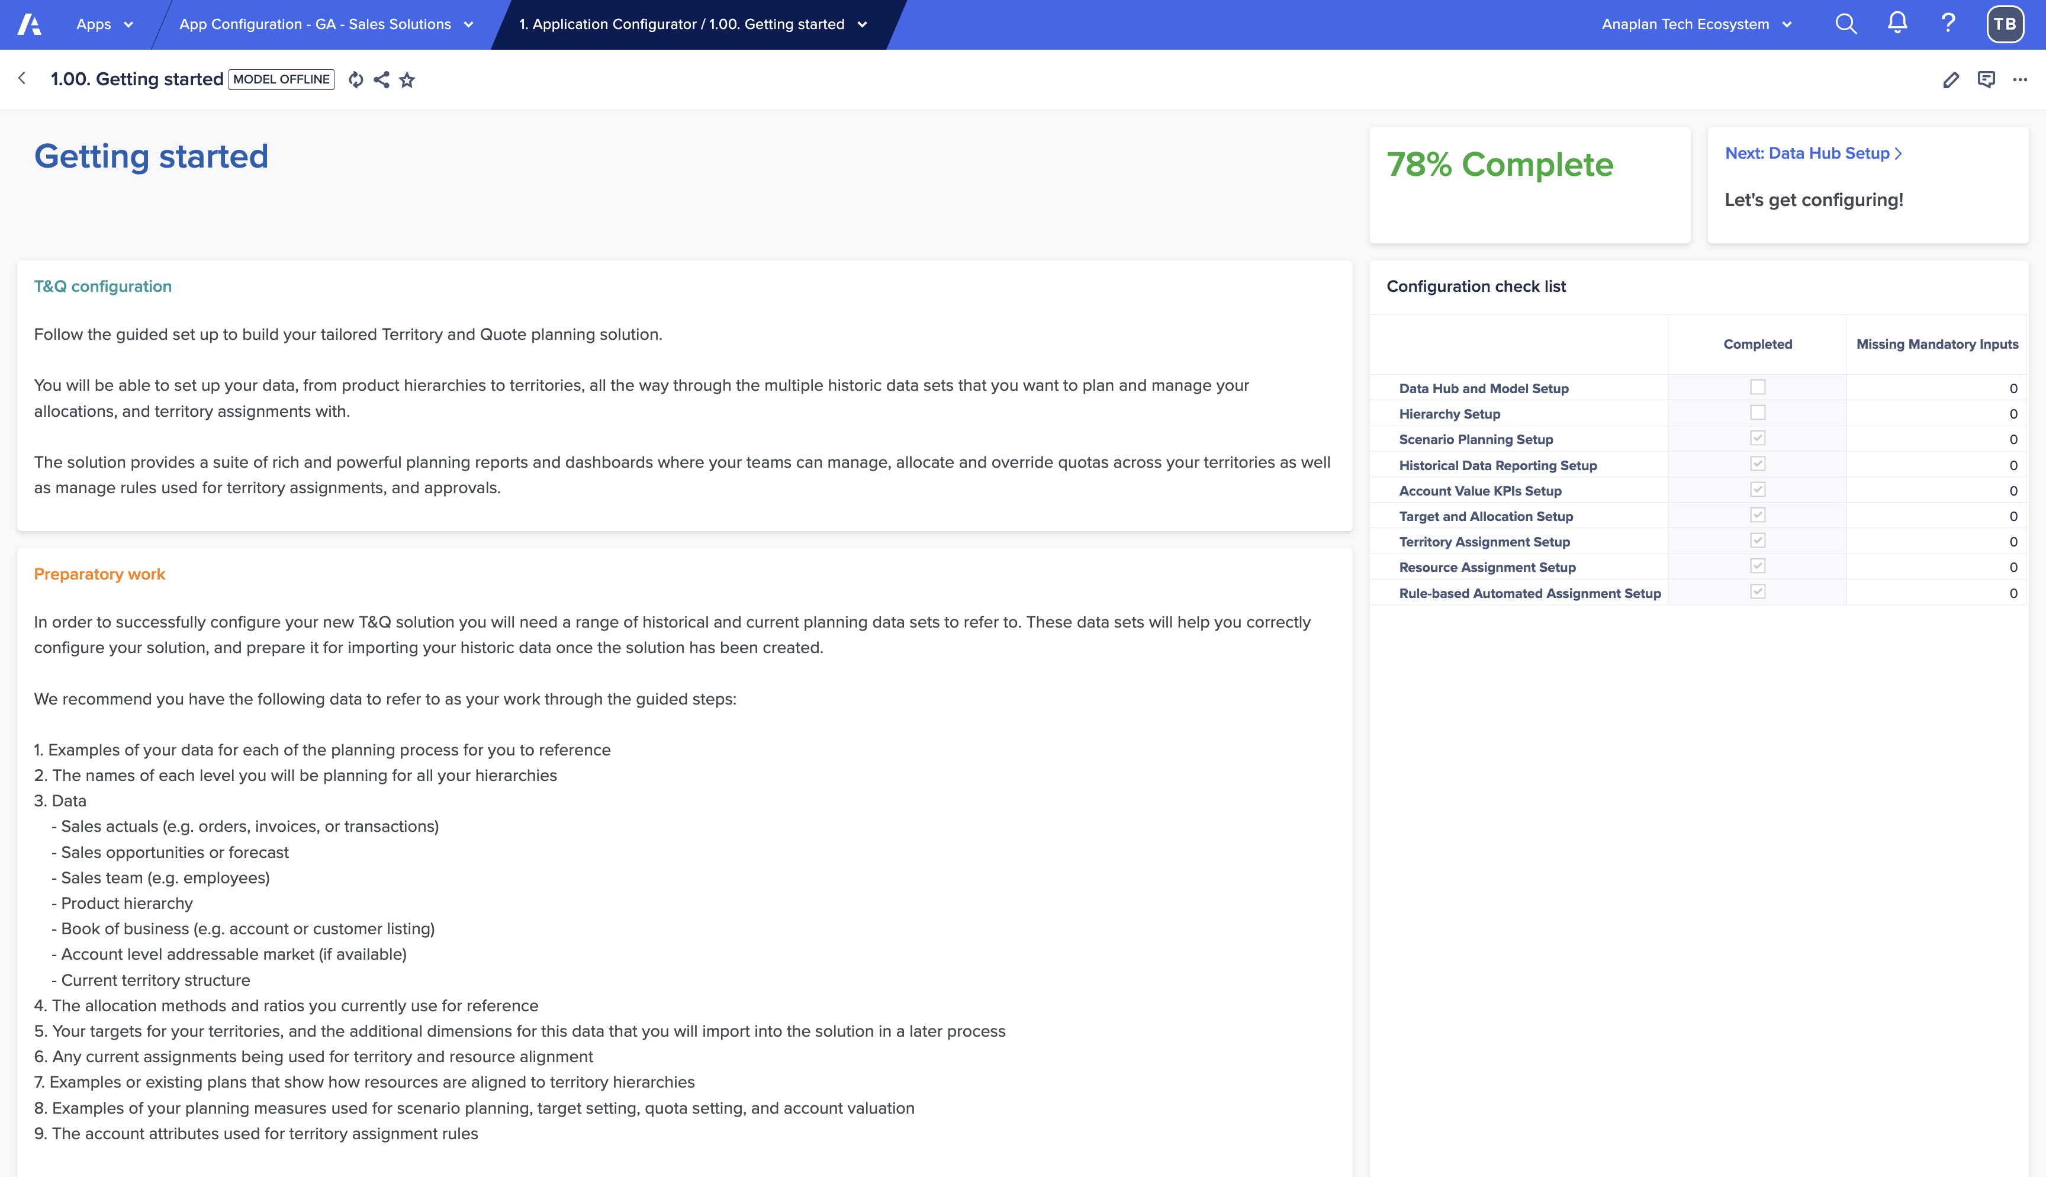
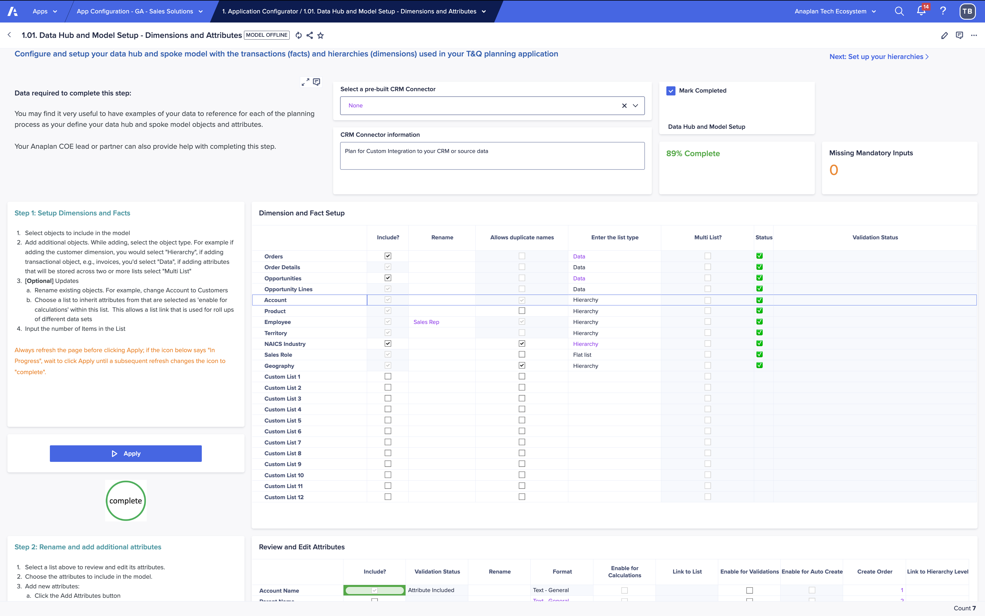
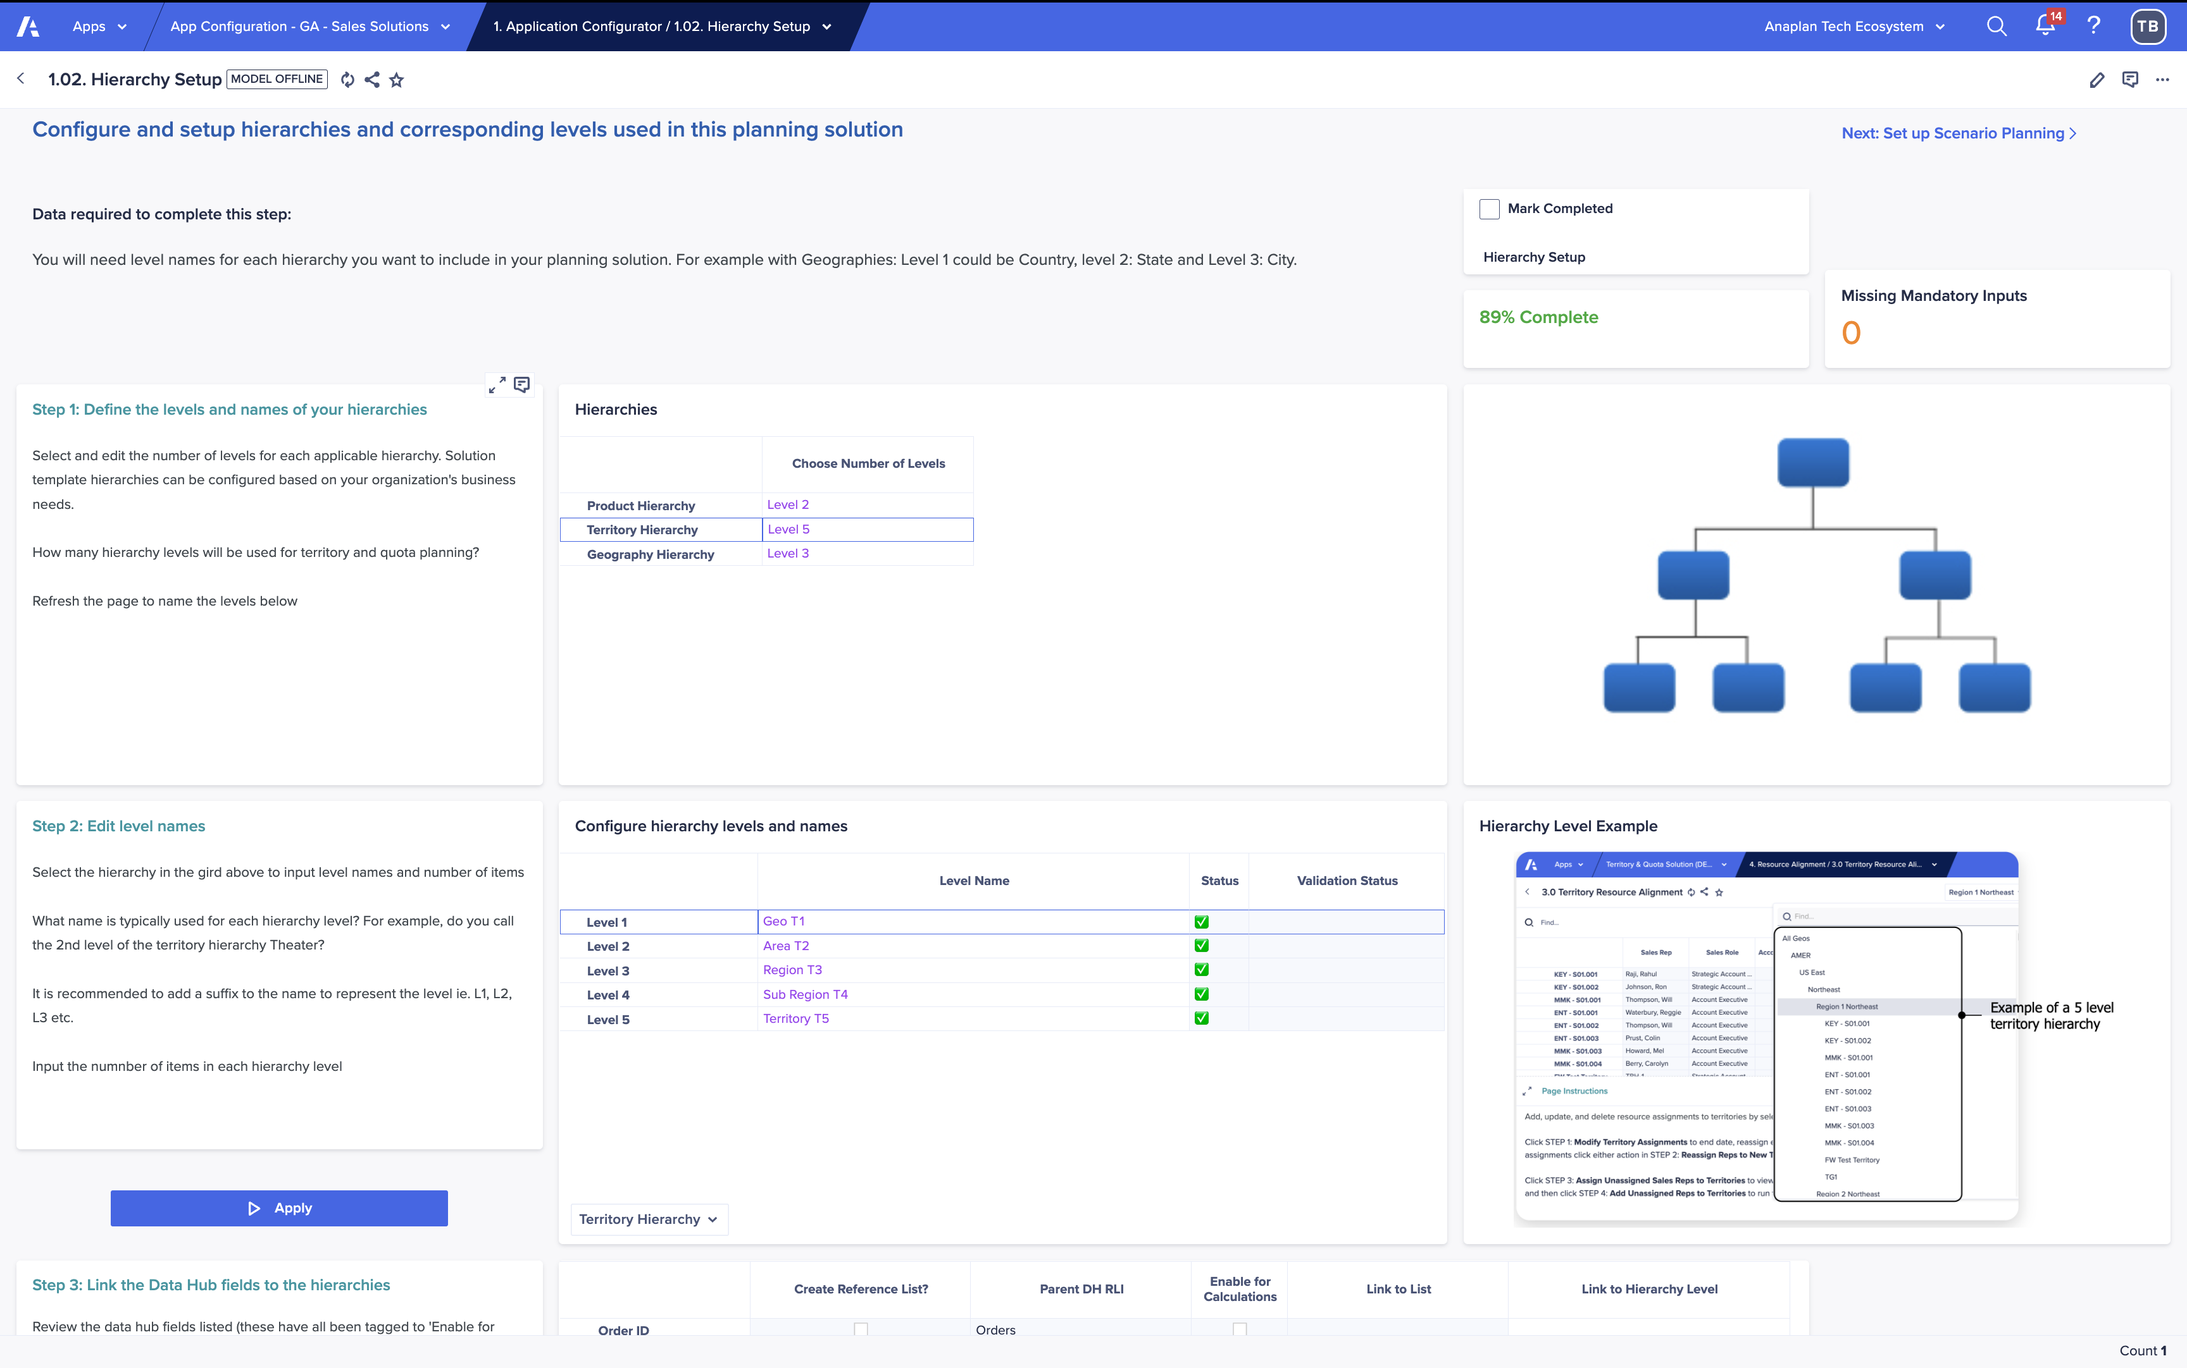
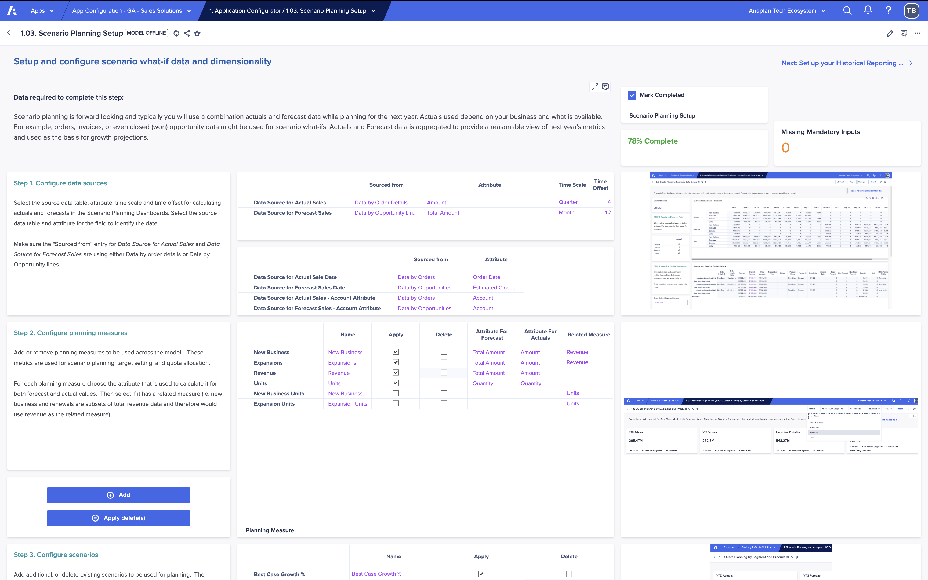
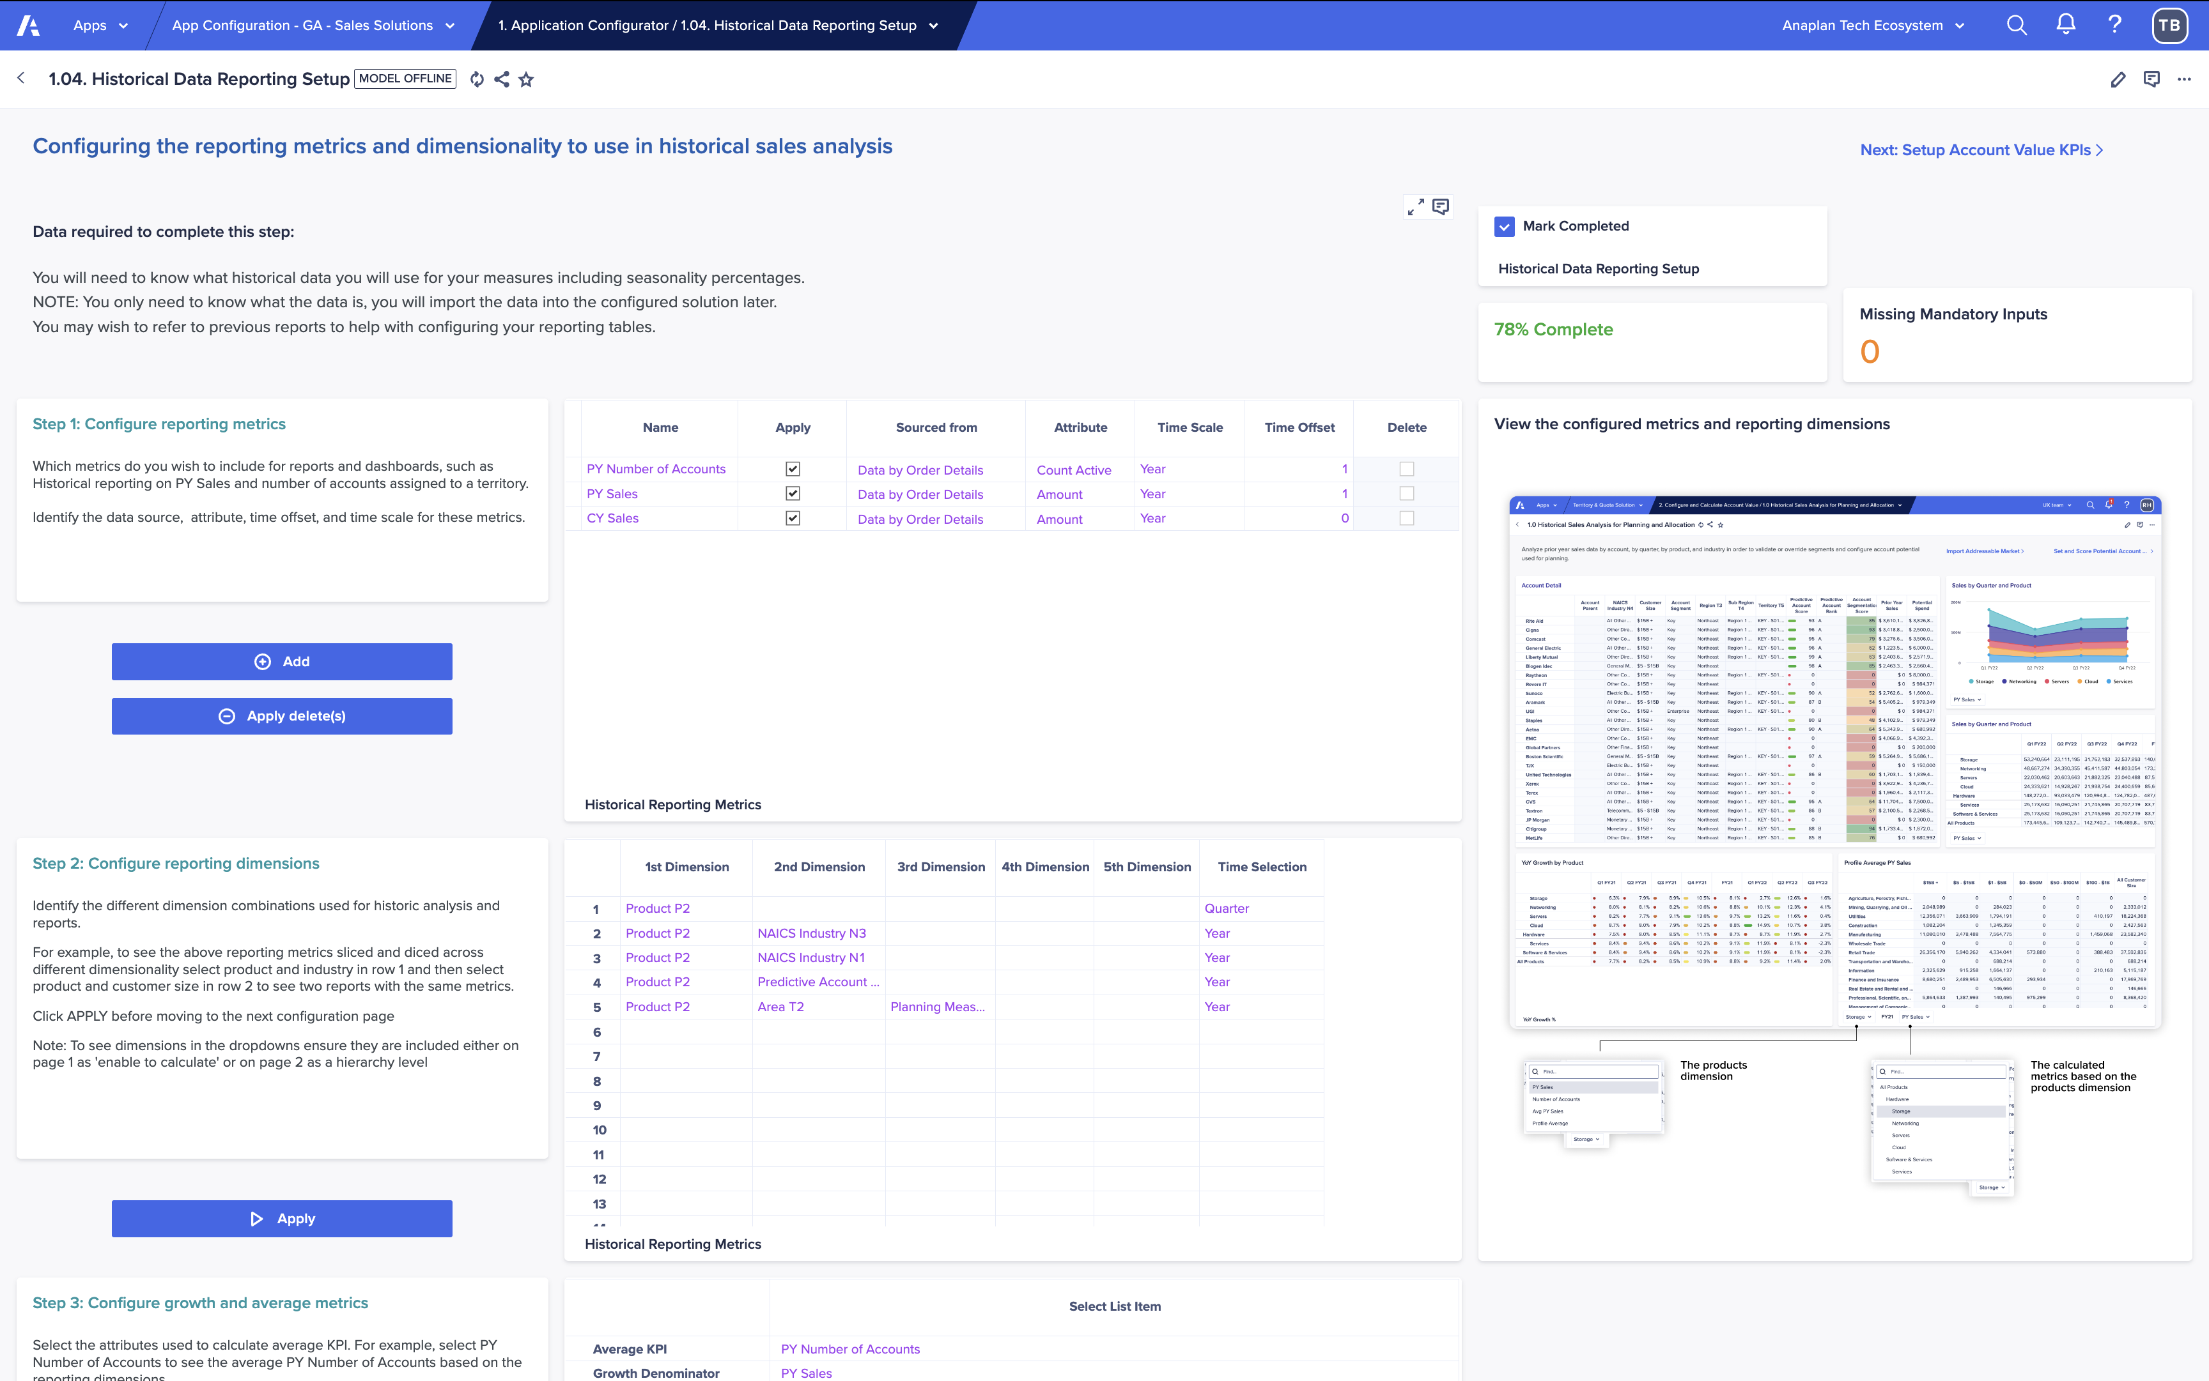

Guided setup powered by the Anaplan Application Framework
Designed to get you to value faster—with a proven, repeatable configuration flow
Guided Setup
Quickly configure your application by answering structured questions about your business model, GTM structure, and planning needs—no blank canvas required.
1
2
3
4
Step-by-step
Configuration
Deploy…
Data
Hierarchies
Resources
Assignments

Slide 7
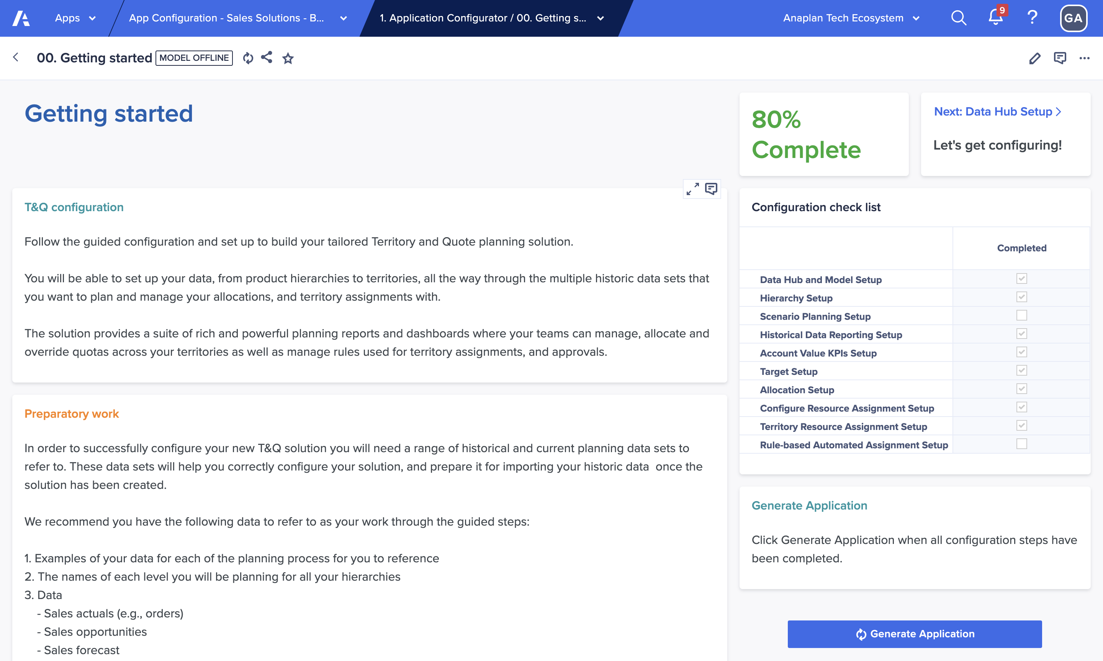
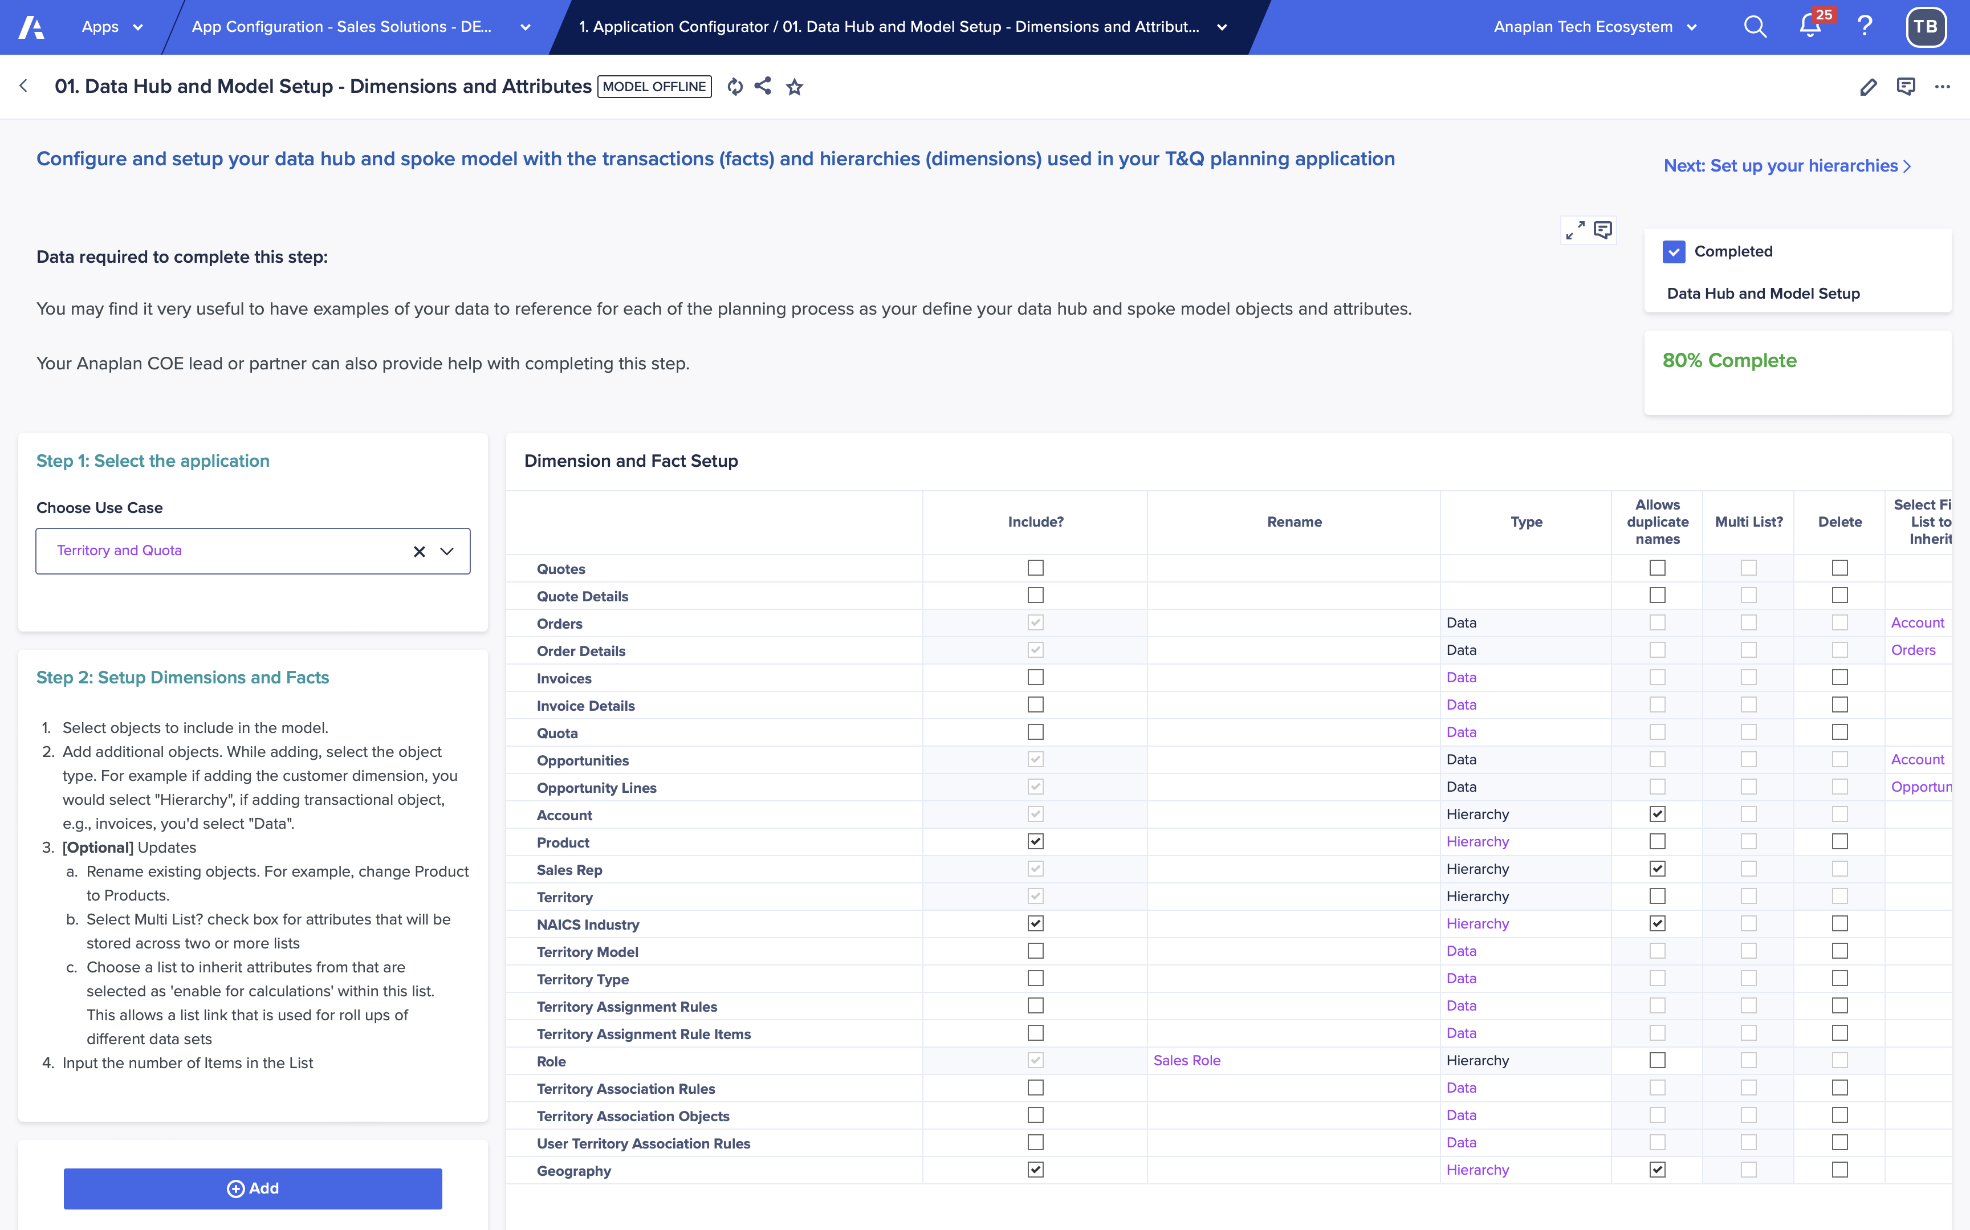
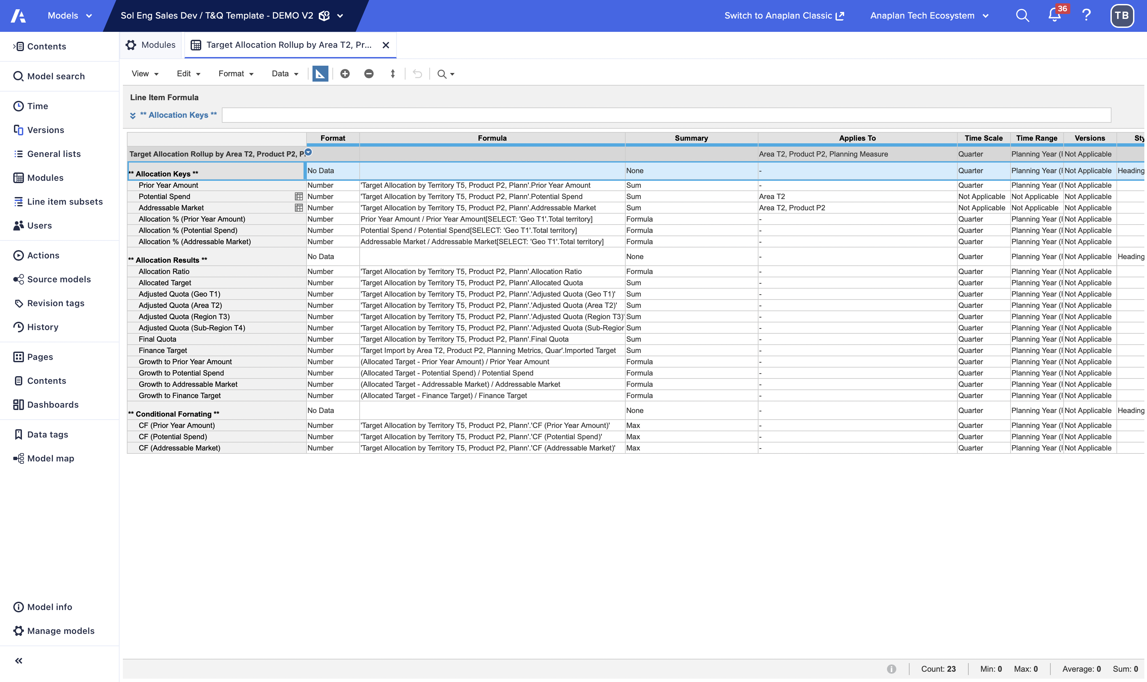
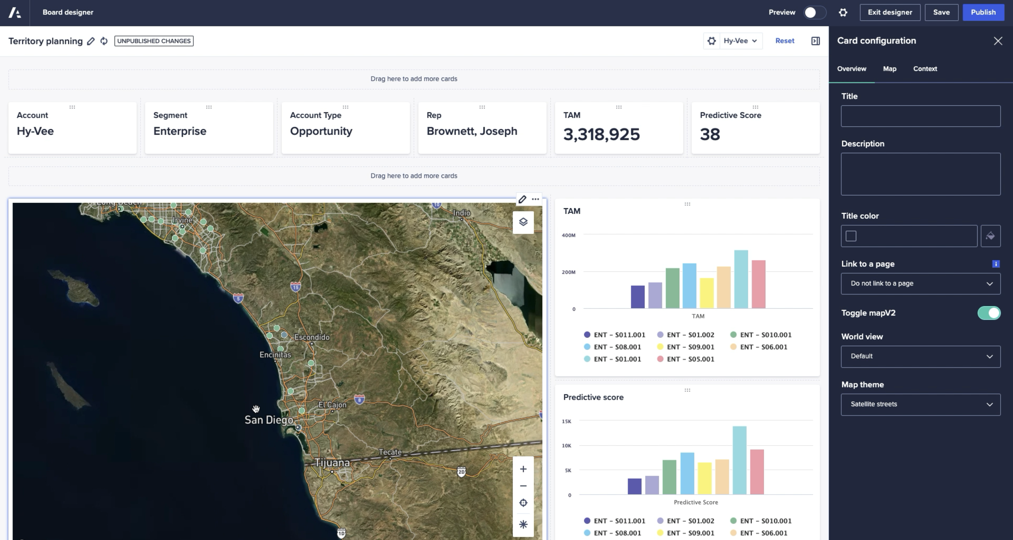
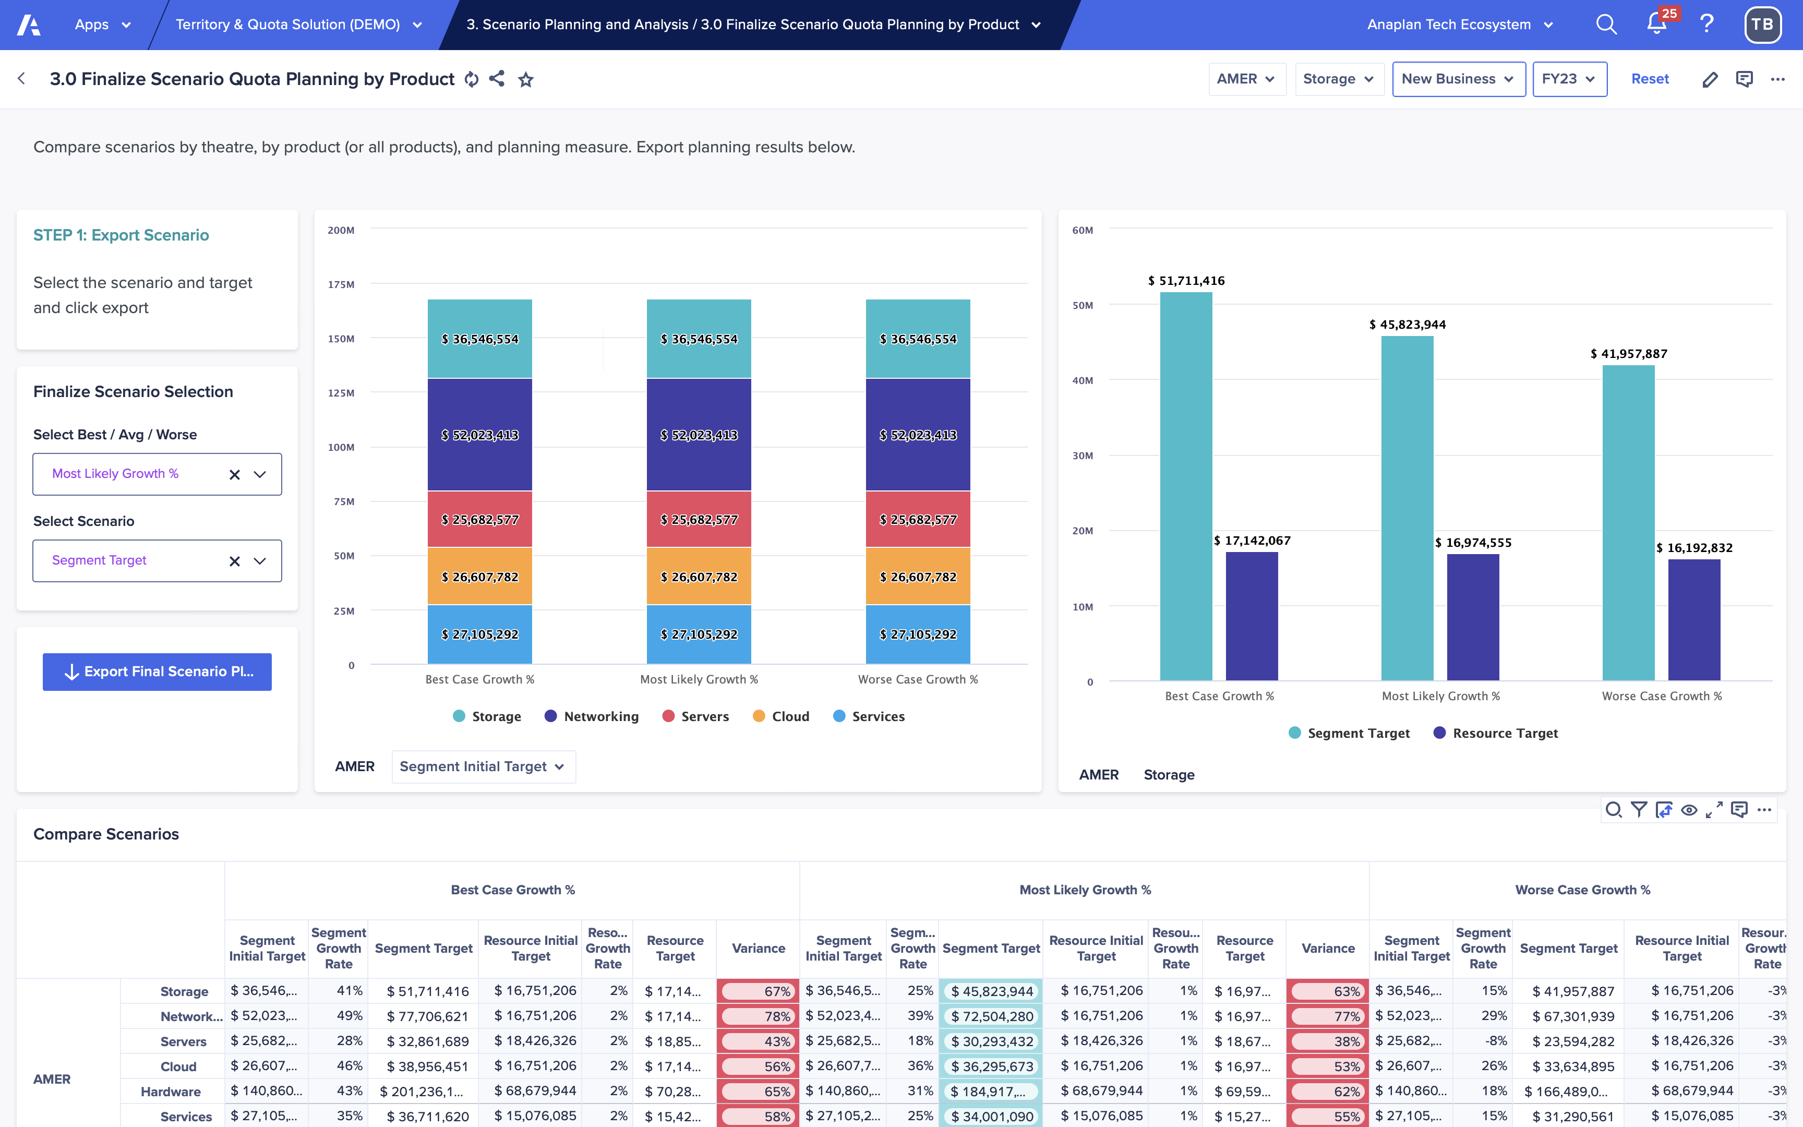
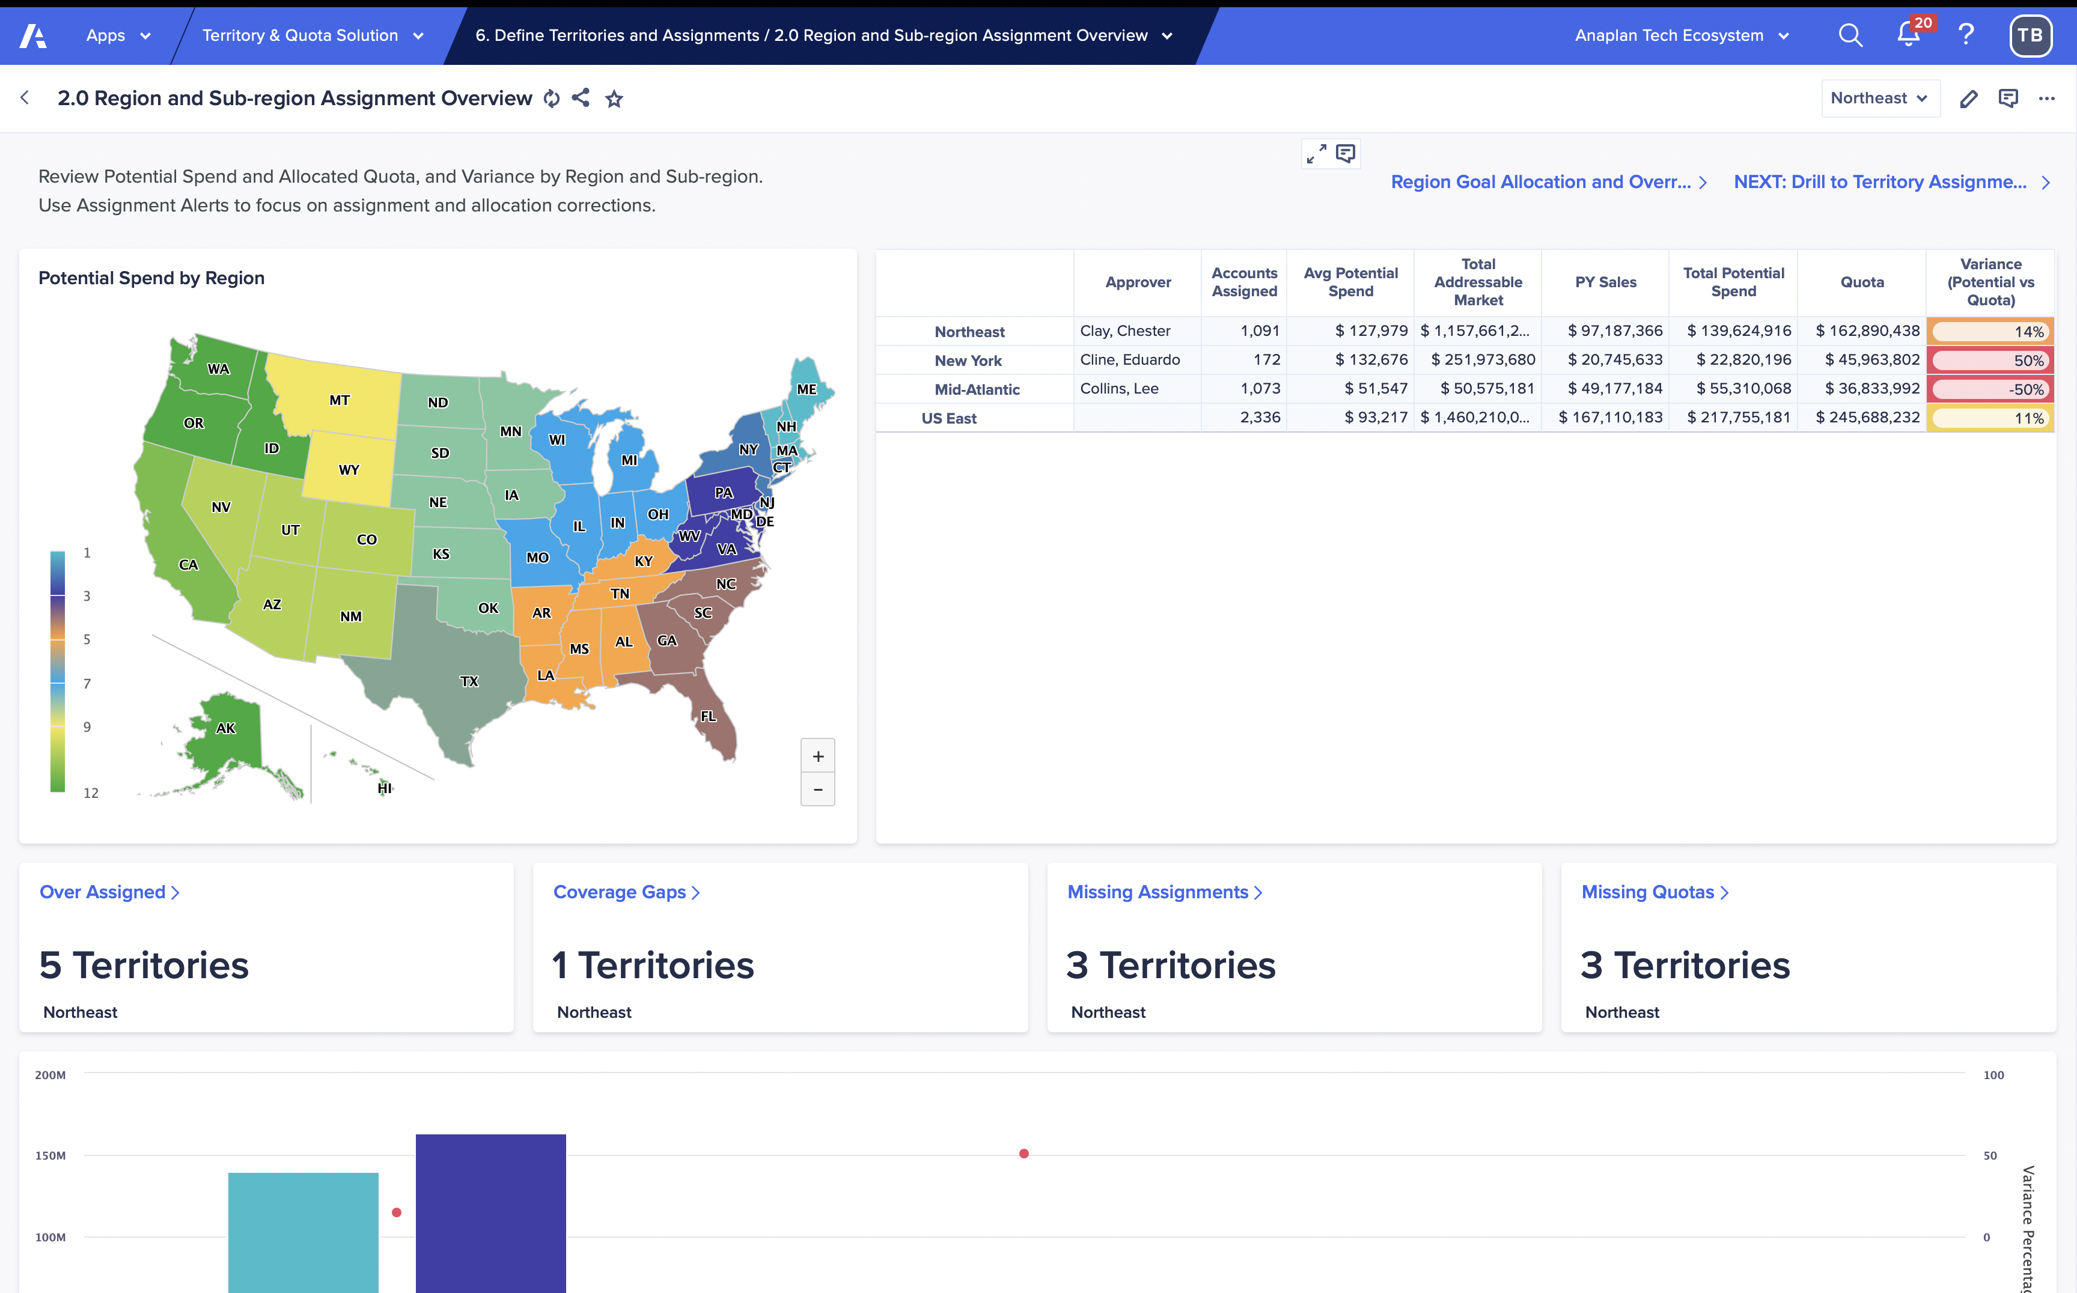
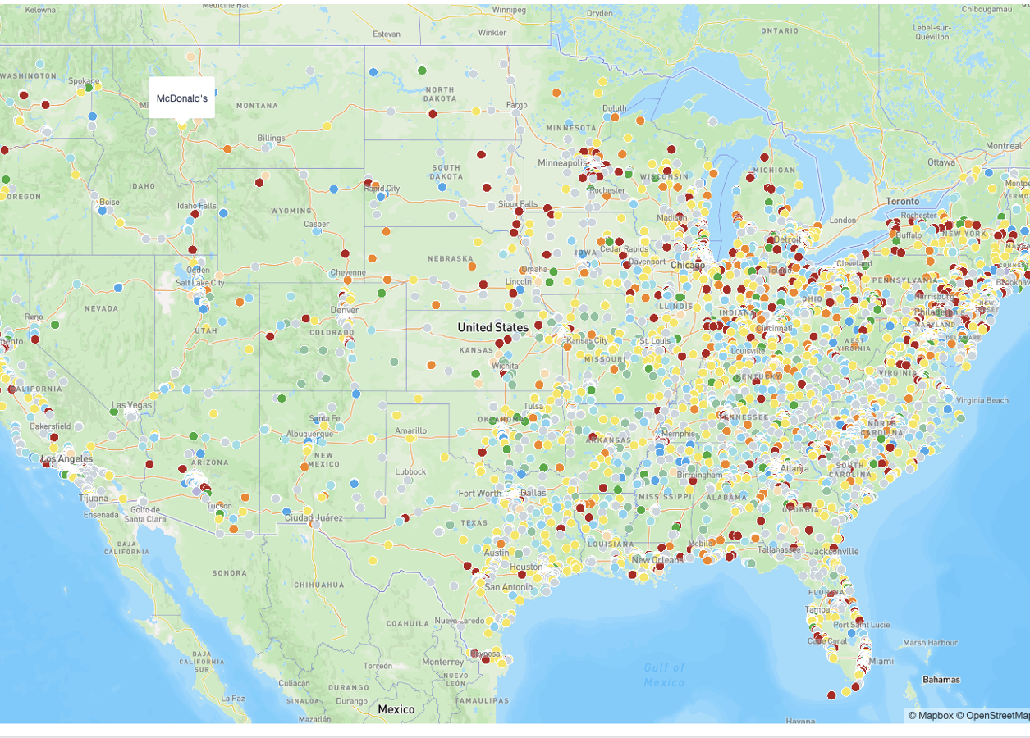
Anaplan Go-to-Market Planning
Application Implementations
3-step implementation: Configure. Extend. Deploy.
Start with a guided setup that builds your model and UX automatically—based on structured inputs about your hierarchies, data, naming conventions, and GTM logic. Your planning foundation is purpose-built from day one.
Configure
Extend
Adapt and expand the application to reflect your business’s unique needs. Leverage the power of Anaplan’s flexible modeling platform to make the
app your own—without starting from scratch.
Deploy
Move quickly into testing and rollout. This accelerated path to deployment helps you capture value sooner, with built-in best practices and a launchpad for future expansion across your business, ready to evolve alongside your business with additional Anaplan applications or purpose-built extensions.

Slide 8
Process and configurable elements
Section 2

Slide 9
Anaplan Segmentation and Scoring Framework
*Account Segmentation
v
1. Market
Analysis
2. Account Refinement
3. Wallet Size
(TAM / Account Value)
4. Account Segmentation
5. GTM
Planning
1.1, 1.2, 1.4
GTM Performance
Analysis
2.1
Define
ICP
3.1
Wallet Size
Calculation
4.1
Customer
Profile
5.1
GTM Modeling
CRM
System
1.3
Country Tier
Analysis
2.2
Manage Account
Hierarchy
3.2
Product Analysis
4.2
Rule-based
Segmentation
3.3
Scenario Analysis
4.3
Score-based
Segmentation
Data
Hub
Booking
System
*Account Segmentation
*New Sales Hierarchy
*Wallet Size
*Account Segmentation
T&Q
Model
Capacity
Planning
Notes:
One of the most valuable assets any enterprise maintains is its data. In an increasingly information-driven, AI world, data is critical to success. From the intricate specifics about every customer and prospect interaction/transaction to granular details about P&L performance and margins, data in the linchpin. But the challenge most companies face is how to turn this growing base of historical, system of record data into a competitive advantage that fully enables cross-functional scenario planning and analysis, and ultimately becomes a forward-looking predictor of ideal outcomes. This is where Anaplan comes in – our platform is purpose-built to simplify the activation of corporate data for granular scenario planning and predictive analytics, so that your data becomes “something that starts working” for you.

Slide 10
Segmentation and Scoring: Key processes and configurable elements
Step | Process name | Process description | Configurability
1 | Market maturity analysis | Define and manage country tiering. Classify markets by maturity and growth potential. Analyze buying behavior by region. Identify and flag restricted or embargoed markets to determine impact. | Select dimensionality and metrics to report on historical sales data. Select data source to calculate KPIs.
2 | GTM performance review | Perform in-depth GTM analytics with configurable dimensions. Track KPIs aligned to CRO-level GTM goals for sales, CS, and marketing. Identify upsell and cross-sell opportunities. Optimize resource allocation using trend-based insights. | Select from the same dimensions/metrics as above. Select dimensionality and metrics to report on historical data. Select data source to calculate KPIs.
3 | Hierarchy refinement | Visualize and validate account hierarchies for clarity. Aggregate firmographics to support account scoring. Refine and align account structures to improve planning accuracy. Group accounts under parent entities for better GTM alignment. Sync hierarchies with GTM strategies. | Select additional firmographics for account dashboard. Select account hierarchy alignment level. Select total level for account parents.
4 | Identify ICP | Exclude accounts that fall outside defined ICP attributes (for example, country tier, region, revenue, employee count). Assess the impact of the exclusion on total wallet size. Prioritize high-potential accounts for focused GTM planning. | Select exclusion criteria to refine ideal customer profiles. Select additional firmographics for account dashboard.

Slide 11
Segmentation and Scoring: Key processes and configurable elements – cont.
Step | Process name | Process description | Configurability
5 | Wallet Size Analysis | Support multiple wallet size methodologies aligned to industry best practices, including Gartner’s. Identify the most relevant methodology by industry or other dimensions. Enable scenario modeling for wallet size projections. Highlight and manage outliers effectively. Incorporate approval workflows for wallet size calculations. | Select scenario modeling. Select spending calculation drivers’ dimension(s). Select wallet calculation drivers' dimension(s). Select spend index hierarchy level. Select wallet reporting dimension(s). Select product reporting dimension(s) and level. Select spending calculation method selection driver. Select accounts filters for bottom-up wallet size input. Select reporting dimension(s).
6 | Account Segmentation Analysis | Profile customers using key attributes. Apply rule-based logic to assign segment categories. Use configurable metrics to create scoring-based segmentation rules. Track segment shifts year-over-year. Collect and incorporate field feedback on segmentation definitions through streamlined workflows. Detect gaps between segment coverage and headcount in real-time. | Select customer profile dimension(s). Select accounts attribute for rule-based segmentation. Select account score to segment mapping driver. Select categorical metrics to score accounts. Select account score metric drivers. Select account segmentation reporting dimension(s).
7 | GTM Strategy (Scenario Planning) | Define and configure new sales hierarchies for precise GTM planning. Leverage account assignment rule. Visualize KPIs aligned to the new GTM strategy and structure. | Select attributes for accounts mapping. Select account reporting hierarchy level.

Slide 12
Prework and assumptions
Section 3

Slide 13
Assumptions
To successfully implement this application as designed,
the planning process must meet the following assumptions.
Assumptions:
Your GTM planning process includes score-based and/or rule-based account segmentation.
You have an existing, structured territory hierarchy available for alignment and reporting.
If these are not true today, there are two options:
Modify or extend the application to accommodate the existing planning model.
Adjust the planning process to align with supported methodologies and industry best practices.

Slide 14
Sales data requirements and description
Data | Description | Mandatory attributes​
Actuals (such as orders, bookings, invoices, transactions, etc.) | This can be either one data file, or it can be loaded with two data files where the second is a more detailed line-item level (such as orders and order lines where the order lines contain details by products). | ID, name, account, product, date, amount, last year wallet, ARR If using the detailed data file, have an ID to link to the initial file. The mandatory attributes must be present between the two data files.
Forecast (such as opportunities, opportunity lines) | This can be either one data file, or it can be loaded with two data files where the second is a more detailed line-item level (such as opportunities and opportunity lines where the lines contain details by products). | ID, name, account, product, date, amount, opportunity owner ID, attribute to filter likely deals (such as forecast category or deal stage) If using the detailed data file, have an ID to link to the initial file. The mandatory attributes must be present between the two data files.
CSV files should be a flat view with the attribute fields in columns and items in rows.
The files can include additional attribute fields.
Additional data files can be brought in as needed.
All files should have a column for "Date Loaded to Anaplan" that should be populated with the current date.

Slide 15
Metadata requirements and description
Dimensions | Description | Mandatory attributes
Accounts (could also be clients, customers, etc.) | Source data for any down-stream account summary reporting | Name, ID, Parent, Territory, Address (city, state, country, postal code), account owner
Opportunity | Source data before down-stream opportunity summary reporting | Name, ID, Account, Product ID, Estimated Close Date, Total Amount, Stage, Stage Entry Date
Product (could also be offerings, services, etc.) | Used in the opportunity detail, order details Historical data import on 3.0 dashboard is by product Product analysis | Name, ID, Parent
Employee (could also be sales reps, sellers, etc.) | Used for reporting purpose to track accounts and opportunity No calculations are dependent on this attribute | Name, ID, territory, manager, email, role, role start date
Territory | Used for any relevant reporting, such as GTM performance reporting by Territory. | Name, ID, Parent
NAICS Industry | Used for any relevant reporting, such as GTM performance reporting by Industry. | Name, ID, Parent
Geography | Used for any relevant reporting, such as GTM performance reporting by Geography. | Name, ID, Parent
Planning Territory | Used for any relevant reporting, such as GTM performance reporting by new planning territory. | Name, ID, Parent
CSV files should be a flat view with the attribute fields in columns and dimension items in rows.
The files can include additional attribute fields.
Additional dimensions and hierarchies can be brought in as needed.
Where numbered lists are referenced (for example, DH Attributes by Account Flat. Account Parent), the value loaded to that field in the data hub should be the CODE, not the name (e.g., 1234 rather than Procter and Gamble).
For files that contain hierarchies, they must be in parent child format. There's no need to include a parent for the first level of the hierarchy.

Slide 16
Model design
Section 4

Slide 17
Model diagram overview
Existing Customer Analysis –
Define UCP / ICP
Define Market /
Account Value
Define Segments
Define Operating
Conditions (GTM Strategy)
Marketing
Signals
Customer
Profile
GTM
Modeling
Pl / 3rd Party
Internal Data
Identify
Evaluate
Account Data
(Customer & Prospect)
Identify ICP
Define Account
Hierarchy
Account Potential:
Spending
Account Value:
Wallet
Account
Rule-Based
Segmentation
Account Segment
Override
Workflow
Account
Segmentation
Internal Data
Historical GTM
Performance
Spending Method
Selection
Scenario
Selection
Account
Score-Based
Segmentation
- Order Data
- Opportunity Data
Analyze
Forecast GTM
Performance
Capacity
Impact
Notes:
One of the most valuable assets any enterprise maintains is its data. In an increasingly information-driven, AI world, data is critical to success. From the intricate specifics about every customer and prospect interaction/transaction to granular details about P&L performance and margins, data in the linchpin. But the challenge most companies face is how to turn this growing base of historical, system of record data into a competitive advantage that fully enables cross-functional scenario planning and analysis, and ultimately becomes a forward-looking predictor of ideal outcomes. This is where Anaplan comes in – our platform is purpose-built to simplify the activation of corporate data for granular scenario planning and predictive analytics, so that your data becomes “something that starts working” for you.

Slide 18
Historical data, existing customer analysis
key modules
Generic module name | Description | Guided setup inputs / explanation
CAL: GTM Performance Analysis by Time | Main reporting modules, which calculate sales metrics by time. | Dimensionality selected in configurator
CAL: GTM Performance Analysis | This is a calculation module to calculate account level performance. This a bridging module used to create LISS to create the map reporting. | Not needed
OUT: Dynamic Map for GTM Performance | This module is used to create geo mapping. It uses LISS from Module: CAL: GTM Performance Analysis. | Not needed
CAL: GTM Performance - Bubble Chart | This module is used to create bubble chart mapping. | Not needed
INP: Tiers Input by Country | Groups countries into tiers for analysis. | Country can also be replaced by other attributes
SYS: Tier DCA Setup by Country Tiers | Default country tier "Country Tiers Unassigned" for any unassigned countries. Write access is disabled for this default tier. | Not needed
OUT: Dynamic Map for Tier Analysis | This module is used to create geo mapping. It uses LISS from Module: CAL: GTM Performance Analysis. | Not needed

Slide 19
Historical data, existing customer analysis model diagram
Existing Customer Analysis –
Define UCP / ICP
Marketing
Signals
Pl / 3rd Party
Intent Data
Identify
Account Data
(Customer & Prospect)
Identify ICP
Define Account
Hierarchy
Internal Data
Historical GTM
Performance
Order Data
Opportunity Data
Analyze
Forecast GTM
Performance
Notes:
One of the most valuable assets any enterprise maintains is its data. In an increasingly information-driven, AI world, data is critical to success. From the intricate specifics about every customer and prospect interaction/transaction to granular details about P&L performance and margins, data in the linchpin. But the challenge most companies face is how to turn this growing base of historical, system of record data into a competitive advantage that fully enables cross-functional scenario planning and analysis, and ultimately becomes a forward-looking predictor of ideal outcomes. This is where Anaplan comes in – our platform is purpose-built to simplify the activation of corporate data for granular scenario planning and predictive analytics, so that your data becomes “something that starts working” for you.

Slide 20
Define account value key modules
Generic module name | Description | Guided setup inputs / explanation
INP: Define Spending Method | This defines what spending method to use to calculate spending. | Dimensionality can be configured
CAL: Wallet Size Calc | This module calculates spending, wallet, and remaining wallet at the account level. | Dimensionality can be configured
CAL: ICP Account Calc | This module calculates ICP and UCP spending, wallet and remaining wallet, which serve as intermediate data modules for downstream summary reporting. | Dimensionality can be configured; Dimensionality matches with CAL: Wallet Size Calc
OUT: Included Firmographics Summary | This module is the main reporting module that summarizes spending, wallet, and remaining wallet of different methods and of different scenarios. | Dimensionality can be configured
OUT: Included Firmographics by Time | This bridging module is used to calculate a specific time-related metric referenced in OUT: Included Firmographics Summary. | Dimensionality can be configured
CAL: Top Accounts Calc | This module is used to view and compare the top accounts' value distribution. | Not needed
CAL: Wallet Override | This module allows account value override at the product level. | Product level is configurable

Slide 21
Define account value model diagram
Define Market / Account Value
Identify
Evaluate
Identify ICP
Define Account
Hierarchy
Account Potential:
Spending
Account Value:
Wallet
Spending Method
Selection
Scenario
Selection
Notes:
One of the most valuable assets any enterprise maintains is its data. In an increasingly information-driven, AI world, data is critical to success. From the intricate specifics about every customer and prospect interaction/transaction to granular details about P&L performance and margins, data in the linchpin. But the challenge most companies face is how to turn this growing base of historical, system of record data into a competitive advantage that fully enables cross-functional scenario planning and analysis, and ultimately becomes a forward-looking predictor of ideal outcomes. This is where Anaplan comes in – our platform is purpose-built to simplify the activation of corporate data for granular scenario planning and predictive analytics, so that your data becomes “something that starts working” for you.

Slide 22
Define segments
key modules
Generic module name | Description | Guided setup inputs / explanation
OUT: Rule-based Assignment Summary | This provides a summary of the rule-based assignment rules. | Attributes used can be configured
INP: Rule-based Assignment | There should be 1 module created for each attribute applied to rule-based assignment. | Should match with # of rule-based assignment
OUT: Rule-based Segmentation Account Details | This module will show account level details on how accounts match with rules. | Not needed
OUT: Segmentation Rule Conflict | There should be 1 module created for each attribute applied to show rule based conflicts | Should match with # of rule-based assignment
CAL: Segmentation Rule Conflicts | This module will compare each rule against each other to determine if there are conflicting account – rule assignments | Ensure # of Shadow Rules >= # of Segment Assignment Rules
INP: Attribute Score | There should be 1 module created for each attribute applied to score-based assignment. | Should match with # of score-based assignment
INP: Account Segment Metric Selection | This module defines what attribute is included to calculate the account score. | Dimensionality can be configured
SYS: Account Segmentation Metric Define | This is a system module which is used to calculate the account score depending on if the attributes applied is a numeric or categorical attribute. It's using the LISS. | Not needed
CAL: Account Scoring Firmographics (For Collect) | This module consolidates all the metrics that will be used to calculate the account score. It's used to create LISS. | Metrics are dependent on attributes included to calculate account score
CAL: Account Scoring Firmographics (Collect) | This module collects the account data and matches account data into a score bucket. | Metrics are dependent on attributes included to calculate account score

Slide 23
Define segments model diagram
Define Segments
Customer
Profile
Account
Rule-Based
Segmentation
Account Segment
Override
Workflow
Account
Segmentation
Account
Score-Based
Segmentation
Capacity
Impact
Notes:
One of the most valuable assets any enterprise maintains is its data. In an increasingly information-driven, AI world, data is critical to success. From the intricate specifics about every customer and prospect interaction/transaction to granular details about P&L performance and margins, data in the linchpin. But the challenge most companies face is how to turn this growing base of historical, system of record data into a competitive advantage that fully enables cross-functional scenario planning and analysis, and ultimately becomes a forward-looking predictor of ideal outcomes. This is where Anaplan comes in – our platform is purpose-built to simplify the activation of corporate data for granular scenario planning and predictive analytics, so that your data becomes “something that starts working” for you.

Slide 24
Define operating conditions
key modules
Generic module name | Description | Guided setup inputs / explanation
INP: Planning Sales Hierarchy Rule Summary | This provides a summary of the planning sales hierarchy rules. | Attributes used can be configured
INP: Planning Sales Hierarchy Rule | There should be 1 module created for each attribute applied to create rules for planning sales hierarchy creation. | Should match with # of attributes applied
OUT: Planning Rule Conflict | There should be 1 module created for each attribute applied to review rule conflicts | Should match with # of attributes applied
CAL: GTM Shadow Planning Rule Conflicts | This module will compare each rule against each other to determine if there are conflicting account – rule assignments | Ensure # of Shadow Rules >= # of Planning Hierarchy Rules
CAL: Planning Sales Hierarchy Account Details | This module will show account level details on how accounts match with rules. | Not needed
CAL: GTM Performance Analysis by Time – Planning Hierarchy | Main reporting modules are dimensioned by Planning Hierarchy, which calculates sales metrics by time. | Not needed
CAL: GTM Performance Analysis – Planning Hierarchy | This is a calculation module to calculate account level performance. This is a bridging module used to create LISS to create the map reporting. | Not needed

Slide 25
Define operating conditions model diagram
Define Operating
Conditions (GTM Strategy)
GTM
Modeling
Account
Segmentation
Capacity
Impact
Notes:
One of the most valuable assets any enterprise maintains is its data. In an increasingly information-driven, AI world, data is critical to success. From the intricate specifics about every customer and prospect interaction/transaction to granular details about P&L performance and margins, data in the linchpin. But the challenge most companies face is how to turn this growing base of historical, system of record data into a competitive advantage that fully enables cross-functional scenario planning and analysis, and ultimately becomes a forward-looking predictor of ideal outcomes. This is where Anaplan comes in – our platform is purpose-built to simplify the activation of corporate data for granular scenario planning and predictive analytics, so that your data becomes “something that starts working” for you.

Slide 26
For more information, refer to applications.anaplan.com

